Slide 1
What is a Docker?

Slide 2
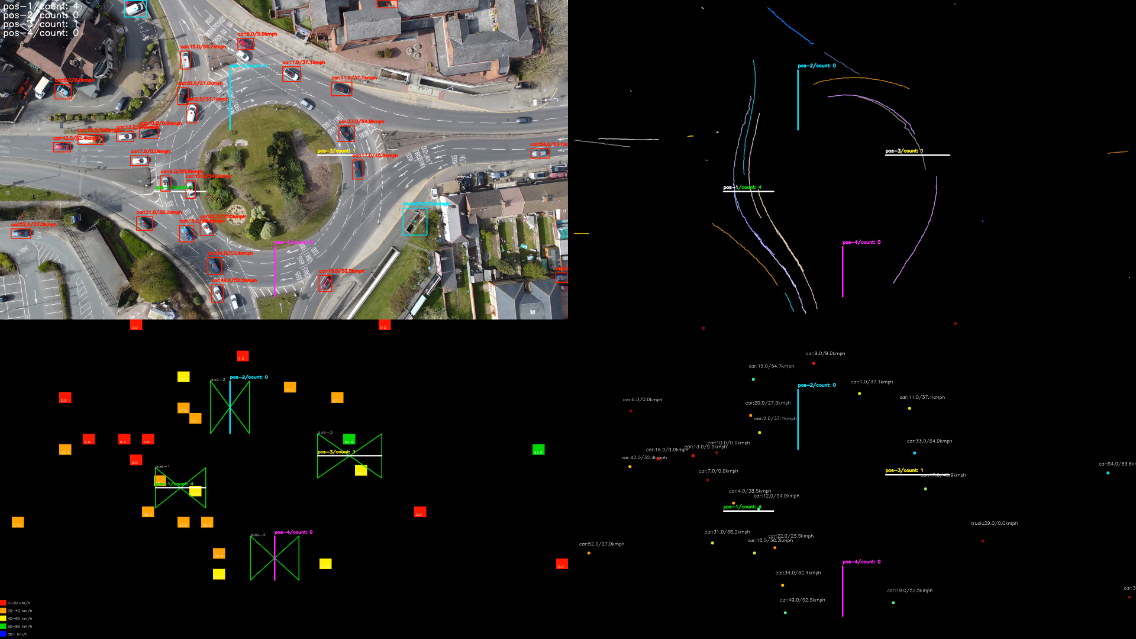

Slide 3




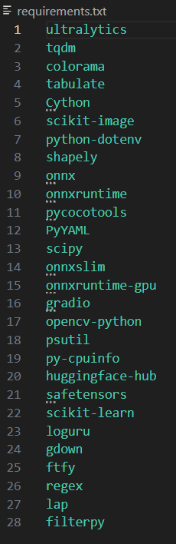


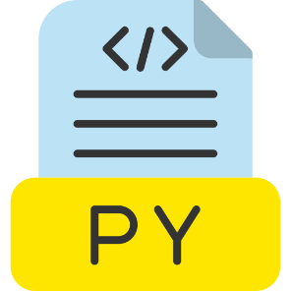

https://www.freepik.com/icon/python-file_8422275
https://www.pngwing.com/en/free-png-xhfqe
https://github.com/rudrabarad/Gifs

Slide 4







DEVELOPMENT
https://www.freepik.com/icon/python-file_8422275
https://www.pngwing.com/en/free-png-xhfqe
https://github.com/rudrabarad/Gifs

Slide 5








DEVELOPMENT
DEPLOYMENT
https://www.freepik.com/icon/python-file_8422275
https://www.pngwing.com/en/free-png-xhfqe
https://github.com/rudrabarad/Gifs

Slide 6




DEVELOPMENT
https://www.freepik.com/icon/python-file_8422275
https://www.pngwing.com/en/free-png-xhfqe
https://github.com/rudrabarad/Gifs

Slide 7

DEVELOPMENT
DEPLOYMENT
https://www.freepik.com/icon/python-file_8422275
https://www.pngwing.com/en/free-png-xhfqe
https://github.com/rudrabarad/Gifs

Slide 8
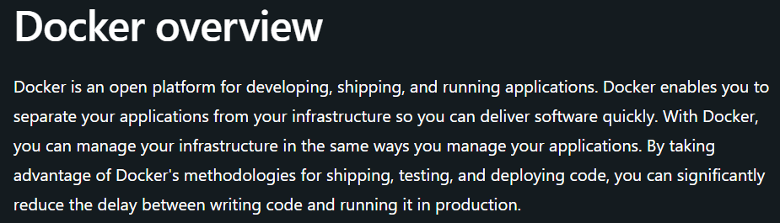
https://docs.docker.com/guides/docker-overview/

Slide 9
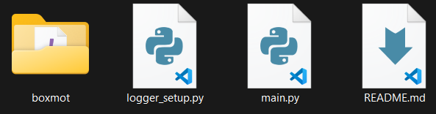
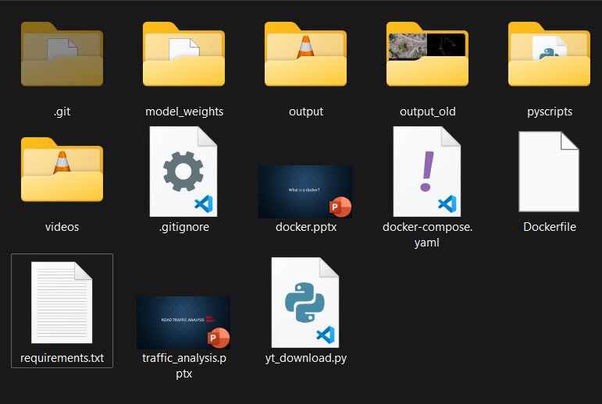

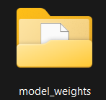
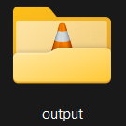

trafficyolo

Slide 10
Docker commands
docker-compose build → to create the docker image
docker-compose up → to create and run a docker container from the docker image
docker-compose down → to remove docker container
docker images → to show all created images
docker ps –a → to show all created containers
docker logs f5g5g9hj556 →to show logs of container with ID f5g5g9hj556
docker rm f5g5g9hj556 → to remove this container
docker rmi 97fha89erc3 → to remove docker image with ID 97fha89erc3

